Slide 1
Workbook Fixed assets – Capex
Internal Use Only
April 2017
EXCEL FILE:

Slide 2
Disclaimer
The content of this workbook has been produced by KPMG Germany/Deal Advisory on the basis of German accounting standards and/or IFRS, as well as considering KPMG Germany’s firm and country requirements, regulations, processes, policies and best practices. Please check your local accounting and other requirements before applying the content.

Slide 3
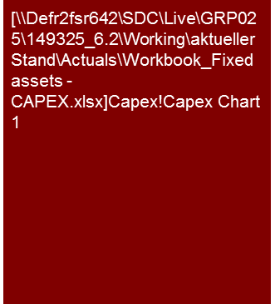
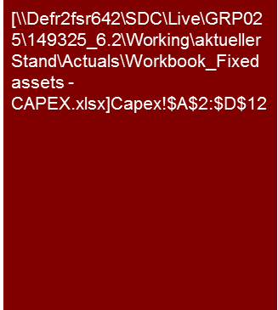
Overview
Historical Analysis of Fixed assets – Capex
Flag: The presentation of fixed assets and capex deviates from accounting standards. This workbook contains example analysis according to IFRS and German GAAP. Check your local GAAP requirements before applying the content.
Mission Statement:
Transparency of average capex requirements (cash flow) taking the respective capex cycles, maintenance expenditures, condition of the equipment and corresponding accounting treatment into consideration.
Customer situation
Definition/Methodology/Tools of the basis analysis
Buy Side/Sell Side/JV
Ratio of capex to depreciation (correlation EBIT to free cash flow)
Identification of capex or maintenance backlog (→ purchase price; SPA clause)
Extent of off-balance-sheet financing (for comparability purposes).
Turnaround
Minimum level of cash is required in order to cover maintenance expenses and capex. Sale of non-core assets or sale and leaseback can be considered in order to improve liquidity.
Capex vs. Depreciation
Definition and Methodology
The aim of the capex analysis is to get an indication of future capex requirements (e.g. if any capex backlog exists) since the respective cash flows should be considered in the valuation of the company. Especially companies with a large fixed asset base (so-called capital intensive companies) require a detailed analysis of capex and maintenance expenses.
Capex is generally analyzed as part of the fixed asset analysis. It is mostly based on additions to intangible and tangible assets.
The comparison of capex to depreciation should be used as the basis analysis. If possible/available, maintenance expenses should also be considered.
The analysis should include the link between the development of sales in the light of capex activities as well as the impact of capex and maintenance on the cost structure of the company.
In case the level of capex fluctuates,
ongoing expenditure ("replacement / maintenance capex"); and
extraordinary expenditure (e.g. expansion capex, extensive modernization/refurbishment, relocation, etc.)
should be analyzed separately.
Understanding the outcome of the analysis requires some knowledge of the business model. Possible influences on the level of capex such as capacity utilization, bottlenecks, expansion plans, outsourcing and leasing should also be considered. A review of the technical or operational DD reports may provide further background on future capex requirements.
Degree of Standardization
Standard: Focus on capex analyses. Further analyses of fixed assets should be agreed in scope of work and priced separately (“extra chargeable work").
Standardized chart and tables to be used in report.

Slide 4
Framework for balance sheet analysis and corresponding workbooks
Historical Analysis of Fixed assets – Capex
Challenge:
Linking the balance sheet analysis to cash flow (balance sheet movements) and P&L analysis (e.g. changes in provisions or inventory valuation → EBITDA adjustments).
Value/Price relevance of the balance sheet analysis
Profile of ”P&L" and "Cash Flow"
Enterprise value (e.g. EBIT x multiple)
Analysis tool - Bucket approach
Workbook "Financing - Net debt"
Direct impact on valuation: financial debt und debt-like items; fair value of pension and other financial liabilities/assets.
Other analyses (assessment of financial stability):
Headroom (available credit lines);
Borrowing profile (key terms and maturities),
Financial gearing, PPA issues
Workbook Provisions + Other Balance Sheet Items
Net (financial) debt
Direct impact on valuation: "Sorting" of other balance sheet items into debt-like (e.g. accrued interest in other payables) or working capital (e.g. provisions for outstanding invoices).
Other analyses
Understanding of cash flow and/or EBIT implications from movements in other balance sheet items;
"Completeness check" for net debt and WC analysis,
PPA issues
+/-
Workbook “Working Capital"
+/- working capital adjustment
Direct impact on valuation: working capital requirements (SPA: level and definition for target WC); drivers of future WC requirements (e.g. working capital days for financial model).
Other analyses (partially relevant for valuation/financing):
Seasonality (→ financing headroom required);
Special effects (impacts from the business model, accounting policies, factoring etc.) → if applicable consider in valuation;
valuation of inventory and debtors, PPA issues.
+/-
Workbook "Fixed assets - CAPEX"
+/-
other adjustments (e.g. Capex backlog)
Direct impact on valuation: Capex and maintenance require-ments (e.g. compared to depreciation, and capex or maintenance backlog)
Other analyses (understanding the business model):
Capacity and utilization, state of technology;
Manufacturing footprint / plant relocations
Fair value (PPA) and impairment issues
=
Equity value/ Purchase price

Slide 5
Pitfalls and lessons learned
Historical Analysis of Fixed assets – Capex
Flag: Applied accounting policies for fixed assets have financial implications on EBITDA and valuation. Samples provided refer to IFRS. Check your local GAAP requirements.
No. | Specific analysis
 | Insufficient focus on valuation-relevant issues Case 1: Potential valuation-relevant issues are not identified or appropriate recommendations are not presented in the report. A highly depreciated asset base or increasing maintenance costs may point towards technical obsolescence, but site visits and discussions with management have proved to be the most effective mean to identify such issues. FDD recommendation may be to perform a technical and/or operational DD in order to determine required level of capex for capacity expansion and modernization. Case 2: We spent too much time on reporting on fixed assets (presentation of a schedule of fixed assets including roll forward, detailed breakdowns of book value by major assets and asset classes, etc.) even though there is no indication for valuation-relevant matters (e.g. based on site visits fixed assets appear "fit for purpose” and there are no signs for capex or maintenance backlog) In both cases it is important to understand the business model in order to be able to focus on the important/relevant points.
 | Implications from (IFRS) accounting policies are not made sufficiently transparent Accounting for fixed assets provides a number of options (e.g. capitalization of development expenses, distinction between capex and maintenance expenses and IAS 16.14 "component approach", finance versus operating lease) and leave room for management judgement (e.g. regarding useful lives to be applied). In a deal environment it is more important to understand the respective financial implications on reported EBITDA/net income (e.g. component approach accounting effectively 'moves' maintenance costs from above EBITDA to depreciation) than to describe the accounting policies as such and comment whether these are in line with the respective GAAP. As an example: impairment charges are non-cash, and as such not valuation relevant, but may indicate commercial and or operational problems). Note: Depending on the customer situation, especially when a buyer's consolidated financial statements post acquisition are likely to receive public attention, the accounting policies as well as an indicative purchase price allocation (PPA) may be of importance, regardless of commercial ("cash") implications.
 | Capex budgeting not sufficiently covered by our analysis: Our capex analysis is often limited to a trend analysis with a comparison to depreciation and maintenance costs, although an analysis of capex budgets and capex budgeting accuracy could provide valuable insights into e.g. a possible capex backlog (and the question if the company can realize major capex projects in time and on budget). When comparing actual to budgeted capex, make sure you understand the ‘planning culture’, i.e. does top management use tight investment budgets to enforce ‘capital efficiency’ or do capex budgets include buffers to be ‘on the safe side’ in case of cost overruns.
 | Investment cycles Significant capex (additional plant, etc. ) often occur in larger intervals of time than the typical standard historical analysis period of 3 years and the costs of recurring major maintenance (according to IFRS frequently to be booked as capex) regularly increase with the increasing age of the plants to be maintained. To avoid misinterpretations it is recommended that at minimum a "qualitative" discussion with the management is held.
1
2
3
4

Slide 6
Core issue (1/2)
Historical Analysis of Fixed assets – Capex
Core Issue | Specific analysis | Page(s)
What is a normal level of capex p.a. ? Are there any indication of a capex and/or maintenance backlog? (How) does capex link to sales development? How long is the average capex cycle (if necessary per asset type or similar)? | Analysis of capex, depreciation and maintenance over time and explanation of trends. Comparison of actual vs. budgeted capex (and individual large capex projects, if applicable). Consider other core issues (issues 2-6). | 8
Are there any operating factors to be considered (e.g. capacity bottlenecks or overcapacities, changes in the business model, plant-relocations or -closures, expected synergy effects, environmental protection regulations, other regulatory conditions, capex allowances or subsidies)? | The scope of the required analysis differs from industry to industry and from company to company. Experience and a profound understanding of the business model is required in order to determine the extent of the analysis as well as the respective level of additional research required. | The core issues presented here are not addressed through quantitative (example) analyses, but are rather more considered qualitatively in the analysis (requires understanding of the business model).
Did the accounting treatment and/or valuation method have any impact on the net book value and depreciation? What is the basis for the differentiation between capex and maintenance expenses? | Analysis of the accounting and economic useful life (and comparison to that of the buyer or competitors). In case of changes in accounting: Presentation of the impact of the changes on the financial statements.
Does the fixed asset base represent the state-of-the-art technology and how does it compare to competitors and/or industry standard? | Analysis of depreciation, the average age as well as any potential impairment. Cooperation with the technical due diligence.
Patents/Valuation: Are there any intangible assets recorded off balance sheet that are necessary for the business (e.g. own research, know how, etc.)? | Identification through questions (Q&A, expert meeting) and from understanding of the business model. Identification and valuation is part of the PPA analysis (if necessary also in the framework of a pre-deal PPA).
Are there non-core fixed assets and at what price could these be sold, if necessary? | Identification through questions (Q&A, expert meeting); valuation, if necessary by specialists for tangible fixed assets.
What financing options does the company use? Buy vs. lease or outsourcing of capital intensive production steps. | Identification through questions (Q&A, expert meeting) and from understanding of the business model.

Slide 7
Core issue (2/2)
Historical Analysis of Fixed assets – Capex
Core Issue | Specific analysis | Page(s)
8. How did capex creditors impact working capital (in particular in cases of significant fluctuations in the capex activity and major one-off projects)? | Search for ”capex creditors" through Q&A or expert meetings (see working capital analysis). | n/a
9. What would be the net book value (‘fair value’) of fixed assets when consolidated for the first time and what would be the impacts on financial statements (in particular respective depreciation in the P&L) in the following years? | Tangible asset valuation in the framework of an (indicative) purchase price allocation ("PPA”) analysis. | n/a
Have fixed assets been impacted by impairments in recent years and/or is there a risk of major impairment charges which may impact reported profitability going forward? Strictly speaking impairments are a non-cash issue, and should not affect valuation and underlying EBITDA. However, we should understand the reasons for historic impairment events and need to consider implications going forward: Have the issues that triggered the impairment been resolved? Is the fixed asset base fit for purpose? will major investments be required to bring plant and machinery into a status which will allow for a cost competitive production (and if so is respective capex included in the business plan)? Furthermore supporting workpapers for impairment tests can be an excellent source of information regarding projections (in addition to a Business Plan which may have been ‚stretched‘ in light of a sales process Finally clients often get nervous when they hear about impairments, and we should be able to explain the reasons which led to the impairment and the potential risk of further impairments | Read the notes to the financial statements, discuss with management / the auditors the last impairment test (procedures and conclusions)

Slide 8
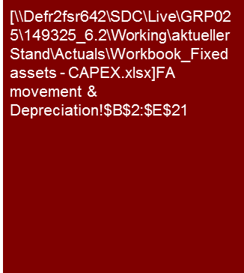
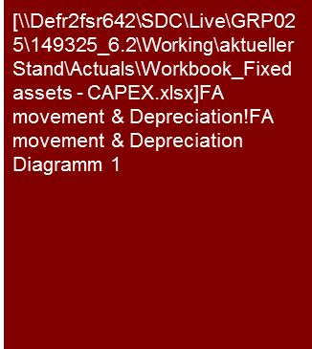
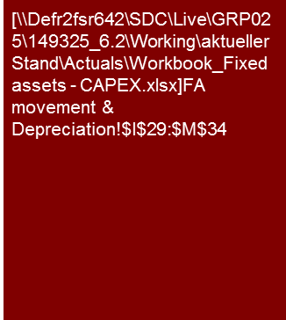
Example analysis – Reporting as part of working capital
Historical Analysis of Fixed assets – Capex
Flag: The example analysis makes reference to BilMoG - The German Act to Modernize Accounting Law (modifies German accounting rules to harmonize them with IFRS.
In 2011 the company sold its old production site for €3.8 million. The proceeds were re-invested to buy a new site and additional technical equipment.
After these investments management sees no need for major additional capital expenditure projects, and based on the capex and maintenance levels for the past three years we have no indication for a potential backlog therein.
Capex and depreciation
Capital expenditure
Main capital expenditure from 2010 to 2012 related to the acquisition of the new company site in 2011 including the purchase of land and buildings and the set-up of appropriate infrastructure. Key infrastructure investments at the new site related to a paint shop and test facilities. In 2012, capital expenditure in these facilities amounted to €189,000.
The remaining capital in 2012 related to IT modernization (€291,000) encompassing software (operating system, CAD systems) as well as hardware (server).
Own development costs were capitalized for the first time in FY10, following new accounting rules introduced by the German BilMoG. In our analysis regarding underlying capex levels focuses on IT and production infrastructure, and hence we have ignored such capitalized development costs, which we believe are.
Management indicated that maintenance related expenditure of the new site (area of 12,000 sqm) is slightly higher than for the significantly smaller old site (area of 1,5000 sqm). Maintenance expenses increased from €84,000 in 2010 to €131,000 in 2012.
Management considers the capital spending for test facilities at the new site in 2011 as a key requirement to be able to perform large orders for stationary installations.
Financed by €3.8 million proceeds for the old production site
Note: Capex excludes capitalized development costs (not considered capex in a cash flow sense)
Source: Annual reports 2010-12; KPMG Analysis
Source: Annual reports 2010-12; KPMG Analysis

Slide 9
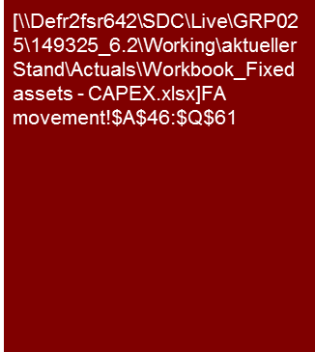
Example analysis 1 – Supplementary appendix presentation
Historical Analysis of Fixed assets – Capex
Note: Especially when the fixed asset base is highly depreciated (low ratio of NBV to historic costs), the analysis should be supplemented by consideration regarding useful lives used (accounting versus economic) and the overall age structure (e.g. Is a major part of machinery close to the end of its economic life?).

Slide 10
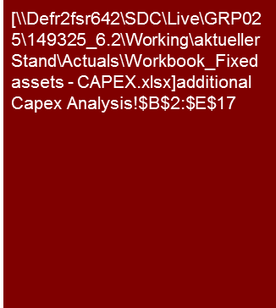
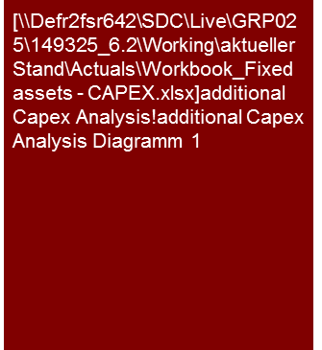
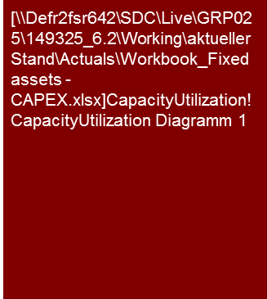
Example analysis 2 – Capex by site
Historical Analysis of Fixed assets – Capex
Average Capex is currently below depreciation due to heavy investment in production infrastructure in 2007/08 (in light of current capacity utilization management expects this to continue for at least the next five years).
2010 and 2011 capex levels reflect a spending freeze following the 2008 crisis and subsequent catch up.
Although the manufacturing footprint is shifting towards Eastern Europe and China, the primary focus of capex is in Western Europe, because operations moved to lower cost regions are less capital intensive.
Note: Analyses on the utilization of capacity must be interpreted carefully. Important aspects are, for instance, the definition of 100% capacity (set-up times required, downtimes for maintenance, shift systems), bottlenecks at individual machines; possibilities for outsourcing, etc.
Capex in % of revenue (frequently used as benchmark) is only meaningful to a limited degree if investments are made for future sales (e.g. New plant). An average for a larger period may be used instead
Capex vs. depreciation
Indicative utilization of production capacity
Source: Management information; KPMG Analysis
Source: Management information; KPMG Analysis

Slide 11
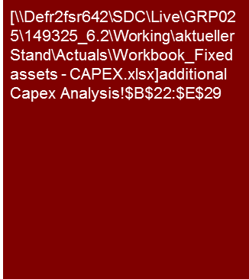
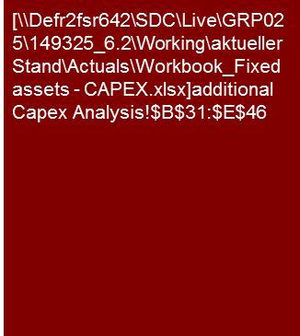
Example analysis 2 – Capex by category and adherence to budget
Historical Analysis of Fixed assets – Capex
Trends in actual capex (fluctuating for equipment, yoy increases for tools) do not allow a conclusion regarding "normal" capex requirements.
In our view the observed variances between actual and budgeted capex are neither a clear indication for a capex backlog nor for its absence, because management has valid explanations for both:
Equipment: restrictive budgets eased in FY11/12;
Tools: traditionally excessive (”conservative") budgets.
Only operational DD (including site visits) could provide comfort regarding normal / future capex requirements.

Slide 12
© 2017 KPMG International Cooperative (“KPMG International”). KPMG International provides no client services and is a Swiss entity with which the independent member firms of the KPMG network are affiliated.

